Slide 1



Infringement
Copyright in the Digital Environment
Amy Thomas
18 February 2026

Slide 2
Format: 11 February
Primary infringement and enforcement (literal + non-literal copying)
Secondary infringement and enforcement (+ secondary liability for platforms)
Formative assessment – overview and Q&A
New date for revision class: Wednesday 25 March
New due date for summative assignment: Monday 13 April

Slide 3
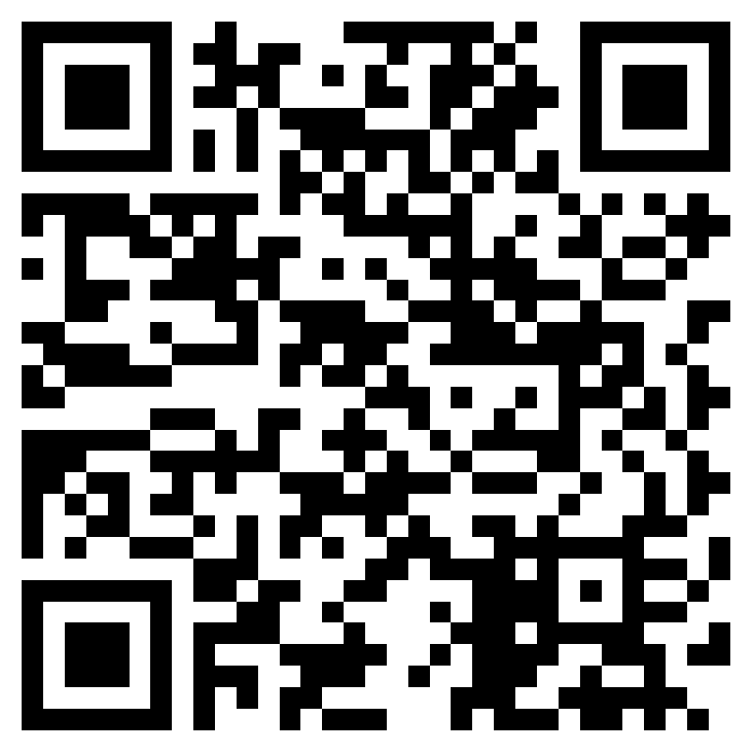
Mid-semester feedback
This form is anonymous – your names/email addresses are not collected or visible to the teaching team – so be as honest as you like!
What have you liked about the course so far?
Is there anything about the course that you would like the teaching team to consider changing?
https://forms.cloud.microsoft/e/3uUt2h2Gws

Slide 4
Work falls within copyrightable subject-matter + fixed permanently + meets the originality standard = copyright
Copyright = Economic and moral rights
Permission is needed to do anything with these rights unless a limitation or exception applies to the activity
If not then = infringement

Slide 5
Primary v secondary infringement
s.16(2) and (3) CDPA: ‘Copyright in a work is infringed by a person who without the licence of the copyright owner does [primary infringement], or authorises another to do [secondary infringement], any of the acts restricted by the copyright.’ (a) in relation to the work as a whole or any substantial part of it […]
Note: mostly concerned with infringement of the reproduction right, but other rights are implicated in infringement (e.g., distribution)

Slide 6
Primary infringement
Where the defendant is the person who, without prior authorisation, did something within the scope of the exclusive rights of the author
Primary copyright infringement is a strict liability tort – mental state is irrelevant if there is causality between the original and derivative work – e.g., an exact copy of the original work (literal copying) or something similar to the original work (non-literal copying)

Slide 7
Primary infringement
Common elements:
Was one of the acts reserved for the copyright owner done? (s16(1) - CDPA)
Derivation – a causal connection between the works?
Substantiality – infringing act in relation to the whole or a substantial part of the work? (= a ‘part’ following Infopaq)
Literal and non-literal copying
Non-literal copying

Slide 8
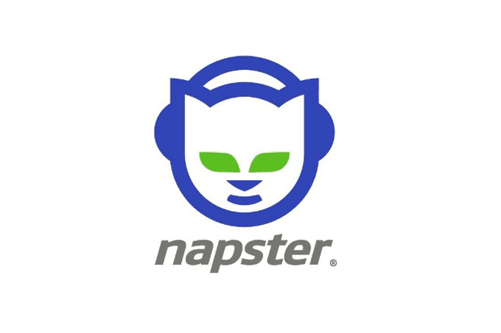


Primary infringement: literal copying
i.e., an exact copy (photocopy of a book or photograph, a download of a song, streaming a film from an unauthorised platform)
Remember: there is no private copying exception in the UK!
Widespread, online ‘piracy’ facilitated by new peer-to-peer technologies, circa 2000

Slide 9
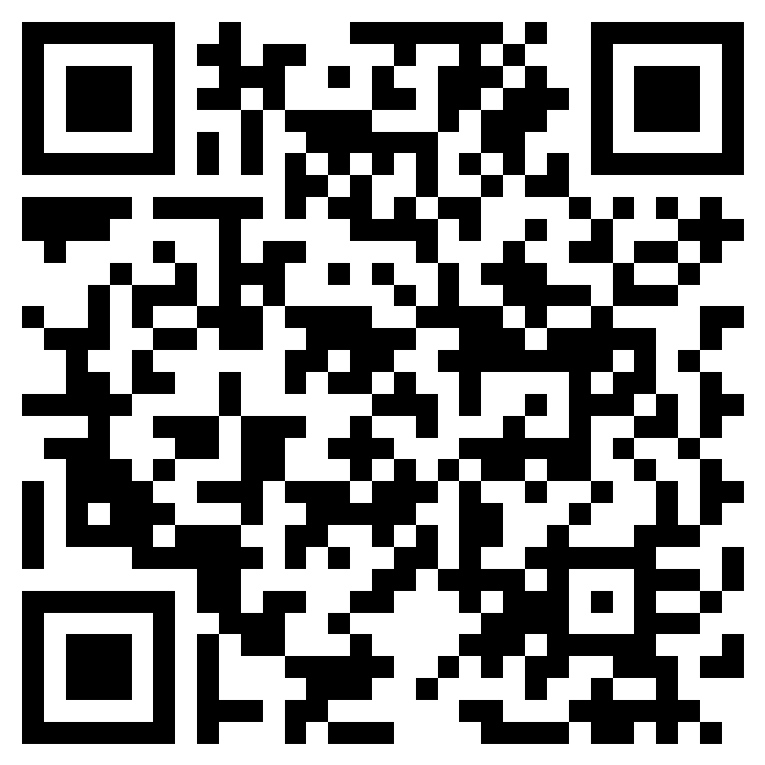
Piracy and streaming
Piracy rates were steadily declining from 2017 to 2021. In 2022, this trend reversed, and piracy rates started to increase. What do you think explains this pattern?
NB: This counts as today’s ‘participation activity’
https://forms.cloud.microsoft/e/H7BD1uLWjX

Slide 10
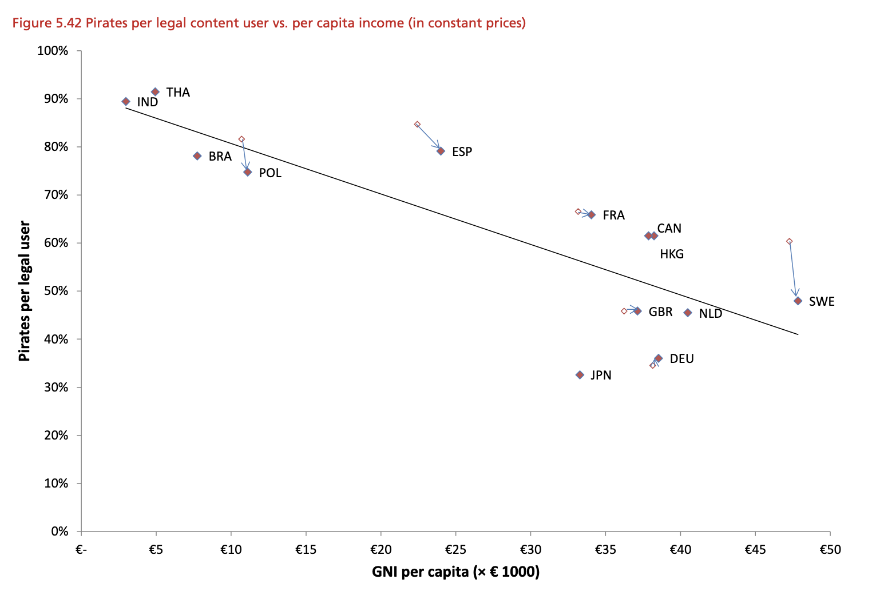
Piracy and streaming
Poort et al (2025) Global Piracy Survey

Slide 11
Piracy and streaming: Secondary infringement
Where someone “knows or has reason to believe” that copies were infringing (CDPA s22-23)
… Or they were ” authorising” infringement (CDPA s16(2))
Important: state of mind matters for secondary infringement – the defendant needs to know or reasonably be expected to know, that the activities were wrongful
Who is liable for uploading infringing content to an online platform? The user or the platform? (or both)? Does YouTube ‘reasonably know’ that infringing content is being uploaded onto their website?

Slide 12
Piracy and streaming: Secondary infringement
UK operates on basis of ex-post notice and takedown
E-Commerce Directive (2014) (US equivalent: Digital Millennium Copyright Act - DMCA) implement the notice and takedown system (aka, the safe harbour)
Article 14: platforms can escape secondary liability if: 1) they have no actual knowledge of the infringement + 2) they act expeditiously to remove content once notified of its existence
Article 15: Prohibition of general monitoring
See also: Online Safety Act

Slide 13
Piracy and streaming: Enforcement and remedies
Civil - e.g., damages, injunction/interdict, account of profits, deliver up
Criminal (very rare!) – in the course of business only (CDPA s107)
Removing infringing content (notice and takedown)
Website blocking (‘s97 Order’)
Cease and desist warning letters (less common in the UK)
Remember: copyright gives rightsholders a choice, but enforcement is not mandatory
Action against primary and/or secondary infringer
Action against the platform

Slide 14
Piracy and streaming: Enforcement and remedies
You want to access Netflix because you want to make a video criticising the portrayal of harmful cultural stereotypes in the programme. You do not have an account with Netflix and don’t want to pay the subscription fee. You are tech-savvy, and have the means to bypass the account verification process and access this without paying anything. Are you legally allowed to do so?

Slide 15
Primary infringement: non-literal copying
e.g., ‘lookalikes’ and ‘soundalikes’
Non-literal copying requires proof of access to the defendant’s original work + substantial objective similarity between the two works = causal connection
Remember: substantiality is a qualitative assessment

Slide 16
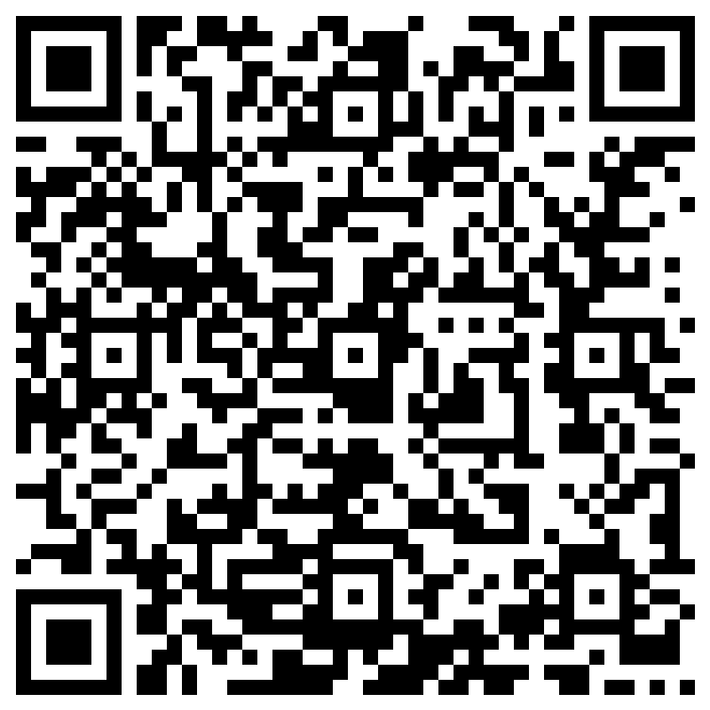
Primary infringement: non-literal copying
What kind of evidence would prove that someone had access to the original work?
https://forms.cloud.microsoft/e/JEEEJvTkaw

Slide 17
Primary infringement: non-literal copying
How would you prove substantial objective similarity between original and derivative works?
… it’s tricky and unpredictable!
Quantitative metrics of similarity of the copyrightable expression – not general elements (Designers Guild v Russell)
Uniqueness or complexity of the copied parts (Mitchel v BBC)
Similarities in the ‘feeling and artistic character’ (Krisarts SA v Briarfine) (but not the ‘idea?’)
Common errors

Slide 18


Primary infringement: non-literal copying
Are similarities more like the result of copying than coincidence? (Designer’s Guild)
Claimant’s work‘Ixia’ Defendant’s work ‘Maguerite’

Slide 19
Primary infringement: non-literal copying
Sheeran v Chokri [2022] EWCH 827
Eight bar chorus similarity between Ed Sheeran’s ‘Shape of You’ vs Chokri’s ‘Oh Why’
Access: inferred by connections in the music industry, interest in popular music scene
Similarity:
Lyrics: “oh why, oh why” vs “oh I, oh I”
Music: Direction of chords are both upwards, tone and rhythmic clicking

Slide 20
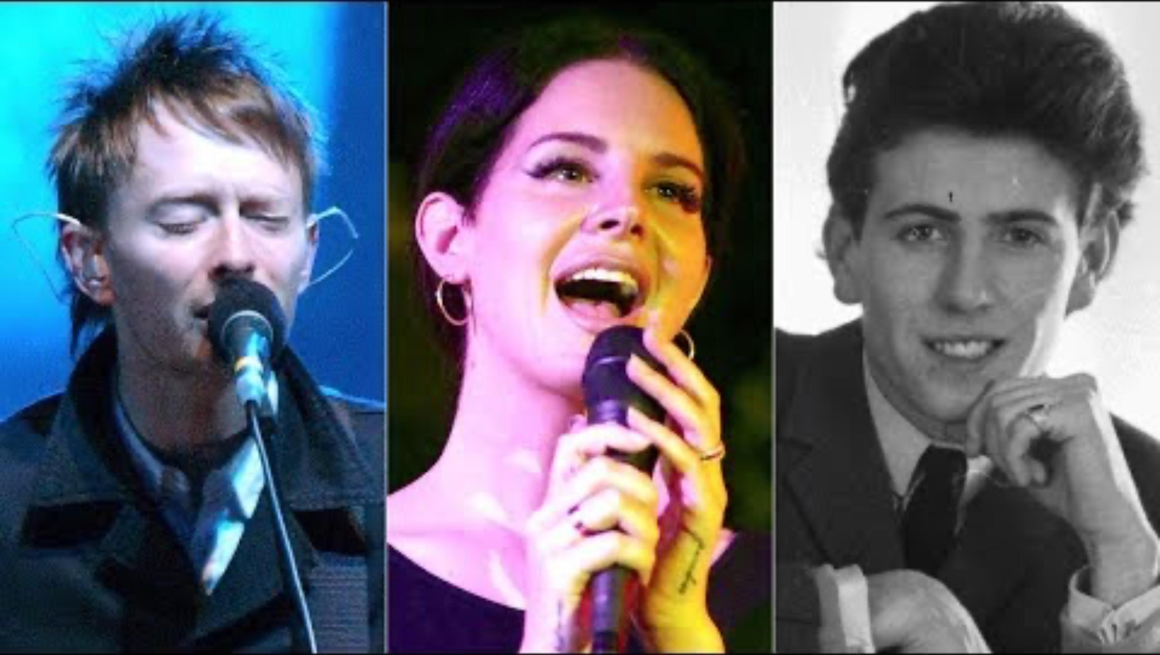
Primary infringement: non-literal copying
https://youtu.be/oaXFc4Zb78s?si=EvJOvLpDbJz-AuRx

Slide 21
Primary infringement: non-literal copying
Note: Special rules for entrepreneurial works <- differences between ‘sound a-likes’ and ‘sampling’
Sound recordings regulated under InfoSoc Article 2 – harmonisation of treatment of reproduction for ‘parts’ of sound recordings
CJEU Pelham GmbH v. Ralf Hütter – using ‘very short audio snatches’ (samples) of approximately two seconds in duration from a recording is infringement
Usually collectively managed (e.g., PRS)

Slide 22
Infringement: summary
Primary infringement includes literal and non-literal copying – non-literal copying is trickier to prove
Secondary infringement is about authorisation/facilitation of copying
Enforcement and remedies are optional, and may be of varying degrees of effectiveness

Slide 23
Formative assessment
Due 11 March 2026 at 4pm
This does not contribute to your overall grade to the course – it is voluntary and ungraded
Students will have the opportunity to submit an essay plan in response to one of the summative essay questions for this course.
This essay plan should be no longer than 500 words and should include:
A ‘thesis statement’ which addresses the question you have chosen. You may wish to frame this around e.g., whether you agree or disagree with the premise of the essay question, and why (and perhaps, how you would defend your position).
A plan for the structure of the essay, with indicative section headings and details of what the section of the essay will cover.
A list of sources (primary and secondary) which you would intend to use.
Additionally, you can identify one secondary source (e.g., academic commentary or article) that you think is of particularly good quality and relevant for your essay. Explain briefly how you will use this in your essay.

Slide 24
Next week
Readings/preparation for Seminar 6 (Performers’ rights)
Any questions/concerns get in touch for office hours (TBD): amy.thomas@glasgow.ac.uk

